Slide 1
CSCI 568: Requirements Engineering
George Edwards
Computer Science Department
University of Southern California
gedwards@usc.edu

Slide 2
About Me
Undergrad in CS at Vanderbilt University (“Go Dores!”)
USC PhD student from 2004-2010
Focused on software architecture, modeling, and analysis
Dissertation: “Automated Synthesis of Domain-Specific Model Interpreters”
Starting teaching CSCI 568 in spring, 2011
Outside of teaching, I work as a software consultant
Litigation consulting and expert witness services
Software intellectual property analysis
Patents
Copyright
Trade secrets
I’m terrible with names
You can just call me “George”

Slide 3
D2L Course Website
Lecture slides
Quizzes (for off-campus students only)
Grades
Discussion board
For students to interact
Questions for me should be emailed to gedwards@usc.edu
Current enrollment: 14 students
12 on campus
2 off campus

Slide 4
Webex
DEN students should log in to the Webex session during class
Follow along with the modeling lesson
Ask questions in real-time
The meeting information is posted on your DEN Blackboard page under the Menu heading "Webex Information.“
Link: https://den.webex.com/den/j.php?MTID=mb1ad5c272bb3c988e021768f19bfd830
Meeting number: 920 473 806
Meeting password: csedwards
Join by phone
1-866-469-3239 Call-in toll-free number (US/Canada)
1-650-429-3300 Call-in toll number (US/Canada)

Slide 5
Grading
Component | Percentage of Final Grade
Quizzes | 40% (~4% for each of ten quizzes)
Homework/participation | 20%
Presentation | 20%
Project | 20%

Slide 6
Weekly Quizzes
At the beginning of each class, starting in Week 4 (~25 minutes)
10 total quizzes
Will cover previous week’s material
2-3 short answer questions covering the previous week’s lecture and reading
Notify me in advance if you will miss a quiz so that arrangements can be made for a make-up
I will make accommodations for:
USC-related activities (such as travel to a research conference)
Illness with documentation
Family emergency with prior approval
I can’t make accommodations for:
Heavy workload

Slide 7
Weekly Homework
Exercises at the end of each chapter
Graded on a participation basis (credit given for any good-faith attempt)
1 point for each question answered – 2 points for questions with an asterisk
Full credit is 60 points total for the semester
6 points per week
Points can be made up by completing more than 6 questions in any week
Due before the beginning of class each week
Must be emailed to gedwards@usc.edu AND the course grader (ravichaa@usc.edu) PRIOR TO THE START OF CLASS. No late homework submissions will be accepted.

Slide 8
Student Presentations
Every student must give a 20 minute in-class presentation on a research paper
DEN students must videotape their presentation and upload to D2L
The list of research papers to choose from is on D2L
Email me (gedwards@usc.edu) AND the grader (ravichaa@usc.edu) with your first and second choices of papers
First-come, first-serve; if your choice isn’t available, we’ll let you know
Depending on the final number of students in the class, we will likely have 1-2 presentations per week
The first student presentations will be February 27
I will give an example presentation in week 2

Slide 9
Class Project
Details on the class project will be provided during the next class
Will involve using a requirements modeling tool to specify requirements
Projects will be due at the end of the semester

Slide 10
Class Agenda
 | Jan. 9 | Jan. 23 | Jan. 30 | Feb. 6 | Feb. 13 | Feb. 27
2-2:25 | Course Intro/Ch. 1 Lecture | Ch. 2 Lecture | Ch. 2 Quiz | Ch. 3 Quiz | Ch. 4 Quiz | Ch. 5 Quiz
2:25-3:15 |  |  | Ch. 3 Lecture | Ch. 4 Lecture | Ch. 5 Lecture | Ch. 6 Lecture
3:15-3:30 |  | Ch. 2 Homework Discussion | Ch. 3 Homework Discussion | Ch. 4 Homework Discussion | Ch. 5 Homework Discussion | Ch. 6 Homework Discussion
3:30-3:40 |  | Break | Break | Break | Break | Break
3:40-4:30 |  | Modeling Lesson | Modeling Lesson | Modeling Lesson | Modeling Lesson | Student presentations
4:30-5:20 |  |  |  |  |  | Project Workshop

Slide 11
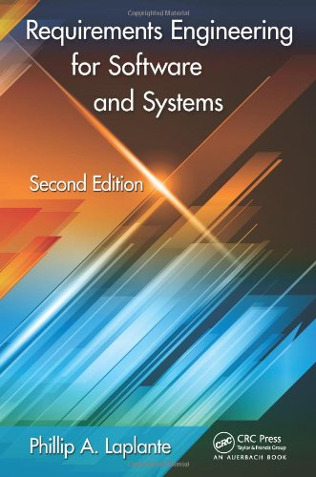
Required Textbook
Requirements Engineering for Software and Systems by Phillip Laplante
I strongly recommend the Second Edition

Slide 12
Office Hours
Office hours are a critical resource for you
If you’re not doing well on the quizzes
If you want early feedback on your presentation
Class time will be set aside for one-on-one project help
Time:
Monday, 11 am – 1 pm
By appointment
Place:
PHE 514

Slide 13
Course Mission Statement
This course is a thorough treatment of the theoretical and practical aspects of discovering, analyzing, modeling, validating, testing and writing requirements for systems of all kinds, with an intentional focus on software-intensive systems.
The course will bring to play a variety of formal methods, social models, and modern requirements writing tools to be useful to the practicing engineer.

Slide 14
Exemplar System I
Airline baggage handling
Embedded, real-time
Moves baggage from a central loading point and redirects to one of many conveyors based on bag id
Denver International Airport tried a such a system
System used PCs, thousands of remote-controlled carts, 21-mile-long track
Carts move along the track, carrying luggage from check-in counters to sorting areas and then straight to the flights waiting at airport gates.
Each piece of baggage has a special bar-coded tag
After spending $230 million over 10 years, project was cancelled*
*See http://ardent.mit.edu/airports/ASP_papers/Bag%20System%20at%20Denver.PDF

Slide 15
Exemplar System II
Pet store point of sale
Organic
Business domain
Cashier functions and inventory tracking
Tax reporting, end of year closeout
PC-based
Transactional
Of course COTS solutions exist, but let’s assume there is a need for a custom system

Slide 16
Today’s Topic: Requirements Engineering Basics
What is requirements engineering?
What are requirements?
Requirements engineering activities
The requirements engineer
Requirements engineering paradigms

Slide 17
What is Requirements Engineering?
“Requirements engineering is the branch of software engineering concerned with the real-world goals for, functions of, and constraints on software systems. It is also concerned with the relationship of these factors to precise specifications of software behavior, and to their evolution over time and across software families.” (Zave, 1997)

Slide 18
Software-Intensive Systems
Software-intensive systems are systems mainly driven by
software
Information systems: software on general-purpose computers
Embedded systems: integration of hardware and software, importance of software growing
Challenges in the development of software-intensive systems
Software-based innovations
Increasing complexity
Pressure to reduce costs
Shorter development times
Higher quality demands

Slide 19
Importance of Requirements Engineering
High impact on project success
Many projects failed or finished with overspend and/or restricted implemented functionality
Requirements defects are reason for approximately 50 % of the cases
Example: London Ambulance Service
Poor requirements process that did not involve ambulance crews
Result: system was not able to operate under realistic conditions (i.e., sending too many ambulances to an incident) which endangered patients lives
Defects in requirements engineering cause high costs
Defect found during programming increases costs by factor 20
Defect found during acceptance test increases const by factor 100!

Slide 20
You Probably Don’t Do Enough Requirements Engineering
Do you do enough requirements engineering? 157 responses (Neill 2003)

Slide 21
A System That Needs Rigorous RE?
http://www.nytimes.com/2012/03/04/business/ibm-takes-smarter-cities-concept-to-rio-de-janeiro.html

Slide 22
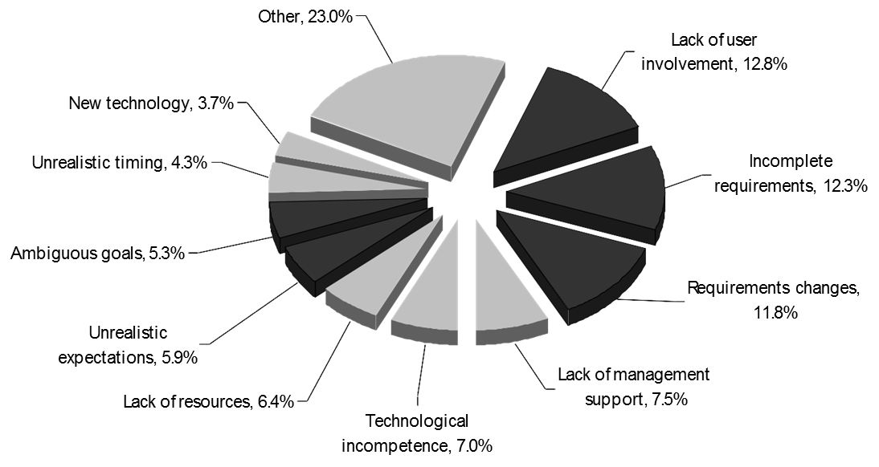
Reasons for resource overspend and/or functional restrictions

Slide 23
What is a “Requirement”?
A condition or capability
... needed by a user to solve a problem or
achieve an objective
... that must be met or possessed by a system or system component to satisfy a contract, standard, specification, or other formally imposed document
A documented form of 1 or 2
A documented requirement is also called requirements artifact

Slide 24
What is a “Requirement”?
Can range from a high-level, abstract statements and back of the napkin sketches to a formal specification
May be textual, graphical, symbolic, or some combination
Different application domains have very different assumptions and constraints
Stakeholders have varying abilities to make and read these representations (e.g., a business customer versus a design engineer)

Slide 25
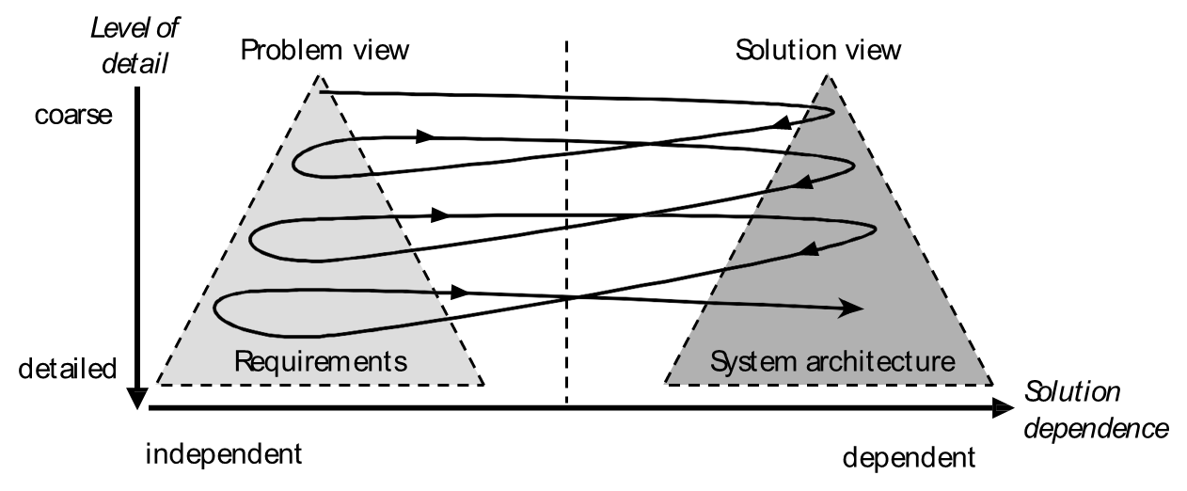
“Twin Peaks” of Requirements and Architecture

Slide 26
Requirements Classification
Sommerville (2005) suggests three levels of abstraction
User requirements
System requirements
Software design specifications

Slide 27
User Requirements
Abstract statements written in natural language with accompanying informal diagrams
Specify what services (user functionality) the system is expected to provide and any constraints
“The system should be able to handle 20 bags per minute”
Examples:
Concept of operations (conops)
System metaphor
User stories

Slide 28
System Requirements
Detailed descriptions of the services and constraints
Derived from analysis of the user requirements
Should be as structured and precise as possible
Acts as contract between client and contractor
May be captured in a functional requirements document (FRD)
Sometimes referred to as functional specification

Slide 29
Software Specifications
The analysis and design documentation used as basis for implementation by developers
Derived from analysis of the system specification
Highly structured and precise
Acts as a contract between REs, architects, programmers, testers, etc.
Usually captured in a software requirements specification (SRS)

Slide 30
Baggage Handling Example
User requirement
“The system should be able to handle 20 bags per minute”
System Requirement
Each bag processed shall trigger a baggage event.
The system shall be able to handle 20 baggage events per minute.
Software specification
1.2 The system shall be able to process 20 baggage events per minute in operational mode.
1.2.1 If more than 20 baggage events occur in an a one minute interval, then the system shall…
1.2.2 More exception handling…

Slide 31
Pet Store POS Example
User requirement
The system shall accurately compute sale totals including discounts, taxes, refunds, and rebates; print an accurate receipt; and update inventory counts accordingly.
System Requirement
Each sale shall be assigned a sale id.
Each sale may have one or more sales items.
Each sale may have one or more rebates.
Each sale may have only one receipt printed.
Software specification
1.2 The system shall assign a unique sales id number to each sale transaction.
1.2.1 Each sales id may have zero or more sales items associated to it, but each sales item must be assigned to exactly one sales id.

Slide 32
Another Way of Classifying Requirements
Functional requirements
Non-functional requirements (NFRs)

Slide 33
Functional Requirements
Specify:
The services the system should provide
How it will react to inputs
What outputs it generates
How and when it changes mode or state
How exceptions are handled
Need to explicitly state what the system should not do
Can be high-level and general (user requirements) or detailed (software specifications).
Many possible forms of representation
natural language
visual models
formal methods

Slide 34
Functional Requirements Baggage Handling System
1.1. The system shall handle up to 20 bags per minute.
1.4. When the system is in idle mode, the conveyor belt shall not move.
1.8. If main power fails, the system shall shut down in an orderly fashion within 5 seconds.
1.41. If the conveyor belt motor fails, the system shall shut the input feed mechanism within 3 seconds.

Slide 35
Functional Requirements Pet Store POS System
4.1. When the operator presses the “total” button, the current sale enters the closed out state.
4.1.1. When a sale enters the closed out state a total for each non-sale item is computed as number of items times the list price of the item.
4.1.2. When a sale enters the closed out state a total for each sale item is computed…

Slide 36
Non-functional Requirements
Requirement imposed by the environment in which the system is to exist
This includes timing constraints, quality properties, standard adherence, programming languages to be used, etc.
Some of these non-functional requirements are counter intuitive (e.g., timing)

Slide 37
Non-functional Requirement Types (Sommerville)

Slide 38
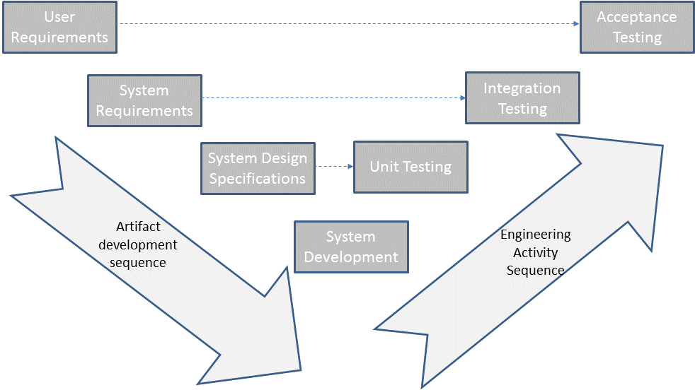
Relationship Between Requirements and Testing

Slide 39
Domain Requirements
Derived from the application domain
May be:
New functional requirements
Constraints on existing functional requirements
Specifications of how particular computations must be performed

Slide 40
Domain Requirements Baggage Handling System
For the baggage handling system, various domain realities create requirements.
Industry standards (you wouldn’t want the new system to underperform versus other airlines’ systems)
Constraints imposed by existing hardware available (e.g. conveyor systems)
Union contracts (there may be constraints based on collective bargaining agreements)

Slide 41
Domain Requirements Pet Store POS System
For the Pet Store POS system, domain requirements are imposed by the conventional store practices.
Handling of cash, credit cards, coupons
Display interface and receipt format
Conventions in the pet store industry (frequent buyer incentives?)
Sale of items by the pound (e.g., horse feed) versus by item count

Slide 42
Requirements Engineering Activities
Requirements elicitation/discovery
Requirements analysis and reconciliation
Requirements representation/modeling
Requirements verification and validation
Requirements management

Slide 43
Requirements Elicitation/Discovery
Goals
Involves:
Discovering who the stakeholders are
Uncovering what the stakeholders need and want
Requirements have to be found and/or teased out
Uncovering what the stakeholders do not want
Don’t forget non-functional requirements!

Slide 44
Requirements Analysis
Raw user requirements exhibit many problems:
Don’t make sense
Contradictory (and not always obviously so)
Inconsistent
Incomplete
Vague
Just wrong
Raw requirements interact and are dependent on each other
Requirements analysis and reconciliation involves techniques to identify and correct these problems

Slide 45
Requirements Representation
Converting the processed raw requirements into some model (usual natural language, math, and visualizations)
Facilitates communication of requirements and conversion into a system architecture and design
Uses techniques that are:
Informal (e.g. natural language, diagrams)
Formal (mathematically sound representation)
Semi-formal (convertible to a sound representation or is partially rigorous)
Usually some combination of these are employed in requirements representation

Slide 46
Requirements Validation
Validation: “Am I building the right system”
Verification: “Am I building the system right?”
Requirements validation involves various semi-formal and formal methods, text-based tools, visualizations, inspections, and so on.

Slide 47
Requirements Management
Managing the realities of changing requirements over time
Fostering traceability through appropriate aggregation and subordination of requirements
Communicating changes in requirements to those who need to know
Intelligently providing “push back” when scope creep ensues
Using tools to track changes and maintain traceability

Slide 48
Home Building vs. Software Development
Home Building | Software/System Building
Architect meets with and interviews clients. Tours property. Takes notes and pictures. | RE meets with customers and uses interviews and other elicitation techniques.
Architect makes rough sketches (shows to clients, receives feedback). | RE makes models of requirements to show to customers (e.g. prototypes, draft SRS).
Architect makes more sketches (e.g. elevations) and perhaps more sophisticated models (e.g. cardboard, 3D-virtual models, fly-through animations). | Architect refines requirements and adds formal and semi-formal elements (e.g. UML). More prototyping is used.
Architect prepares models with additional detail (floor plans). | RE uses information determined above to develop complete SRS.
Future models (e.g. construction drawings) are for contractors’ use. | Future models (e.g. software design documents) are for developers’ use.

Slide 49
Behavior Specification
Universe of all possible system behaviors
Desired system behavior
Behavior specified
Missing functionality
Undesirable behavior allowed by spec
Unwanted behavior excluded by spec

Slide 50
Other topics covered this semester
Agile requirements engineering
Tool support for RE
Value engineering of requirements
Software patents

